Slide 1
Agenda: Physical Access in Health Care
ADA General Concepts and Applicability
Parking, Passenger Loading Zones and Drive-thru Medical Testing
Building and Office Accessibility
Accessible Exam Rooms and Waiting Areas
Accessible Medical Diagnostic Equipment

Slide 2
Learning Objectives:
Understand how the ADA applies to health care facilities.
Identify areas of health care facilities in which physical accessibility is required.
Learn how to address common barriers to access in health care facilities.

Slide 3
Accessibility in Healthcare
Accessibility of doctors' offices, clinics, and other health care providers is essential in providing medical care to people with disabilities.
Due to barriers, individuals with disabilities are less likely to get routine preventative medical care than people without disabilities.
Accessibility is not only legally required; it is important medically so that minor problems can be detected and treated before turning into major and possibly life-threatening problems.

Slide 4
ADA Overview and Requirements I
The Americans with Disabilities Act of 1990 (ADA) is a federal civil rights law that prohibits discrimination against individuals with disabilities in everyday activities, including medical services.
Disability – A physical or mental impairment that substantially limits one or more major life activity
The ADA ensures access to the built environment for people with disabilities.
Enforced by the Department of Justice
Uses the 2010 Standards for Accessible Design.

Slide 5
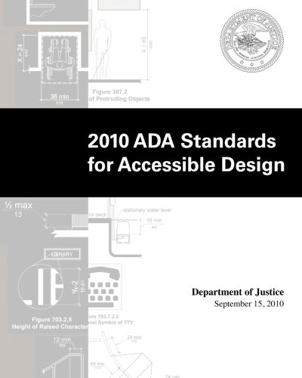
ADA Overview and Requirements II
Design standards developed and updated by the US Access Board.
Apply to places of public accommodation, commercial facilities, and state and local governments.
Became enforceable in 2012 – for all new construction, alterations, program accessibility, and barrier removal.

Slide 6
ADA Overview and Requirements III
Title II (State and Local Government)
Public Hospitals, Clinics, Medical Offices
Title III (Public Accommodations)
Private Hospitals, Clinics, Medical Offices
Both must provide:
Full and equal access to healthcare services and facilities
Reasonable modifications to policies practices and procedures

Slide 7
ADA Overview and Requirements IV
Existing Facility Accessibility Requirements
Title II
Program as a whole must be accessible.
May mean removing architectural barriers or adopting alternative measures.
Title III
Readily achievable barrier removal.
If barriers cannot be removed, must make services available through alternative methods.

Slide 8
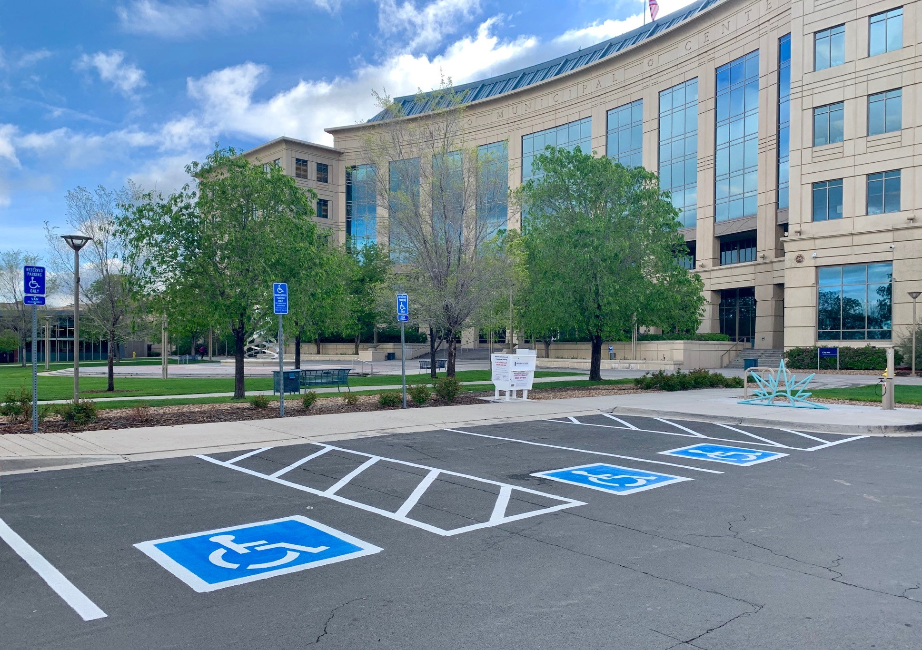
Parking Requirements
Parking facility includes parking lots and parking structures
The number of parking spaces required to be accessible is to be calculated separately for each parking facility; not based on the total number of parking spaces provided in all the parking facilities provided on the site.

Slide 9
Parking Requirements – Scoping I
Table 208.2 Parking Spaces
Total Number of Parking Spaces Provided in Parking Facility | Minimum Number of Required Accessible Parking Spaces
1 to 25 | 1
26 to 50 | 2
51 to 75 | 3
76 to 100 | 4
101 to 150 | 5
151 to 200 | 6
201 to 300 | 7
301 to 400 | 8
401 to 500 | 9
501 to 1000 | 2 percent of total
1001 and over | 20, plus 1 for each 100, or fraction thereof, over 1000

Slide 10
Parking Requirements – Scoping II
Hospital Outpatient Facilities. Ten percent of patient and visitor parking spaces provided to serve hospital outpatient facilities must be accessible.
Intended to cover facilities or units that are located in hospitals and that provide regular and continuing medical treatment without an overnight stay.
Doctors' offices, independent clinics, or other facilities not located in hospitals are not considered hospital outpatient facilities.

Slide 11
Parking Requirements – Scoping III
Rehabilitation Facilities and Outpatient Physical Therapy Facilities. Twenty percent of patient and visitor parking spaces provided to serve rehabilitation facilities specializing in treating conditions that affect mobility and outpatient physical therapy facilities must be accessible.
Conditions that affect mobility:
Conditions requiring the use of a mobility aid;
Arthritic, neurological, or orthopedic conditions;
Respiratory diseases and other conditions; and
Cardiac conditions that impose significant functional limitations.

Slide 12
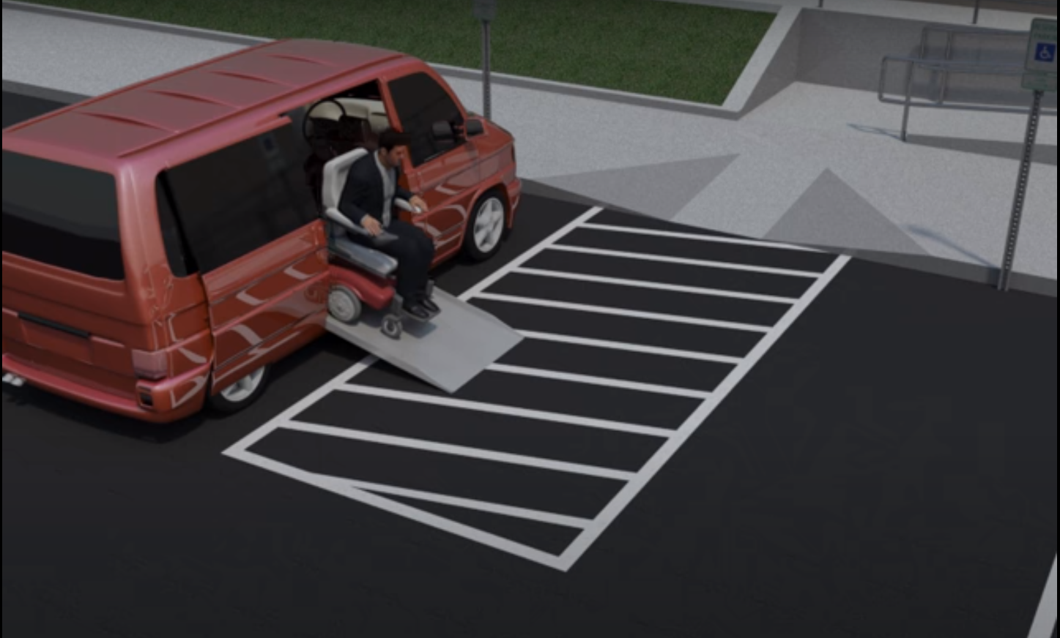
Parking Requirements – Scoping IV
Van Parking Spaces. For every six or fraction of six parking spaces required to be accessible, at least one shall be an accessible van parking space.

Slide 13
Parking Requirements - Location
Accessible spaces for a particular building must be located on the shortest accessible route from parking to an accessible entrance.
Where parking serves more than one accessible entrance, accessible parking spaces shall be dispersed.
In parking facilities that do not serve a particular building, accessible spaces must be located on the shortest accessible route to an accessible pedestrian entrance of the parking facility.

Slide 14
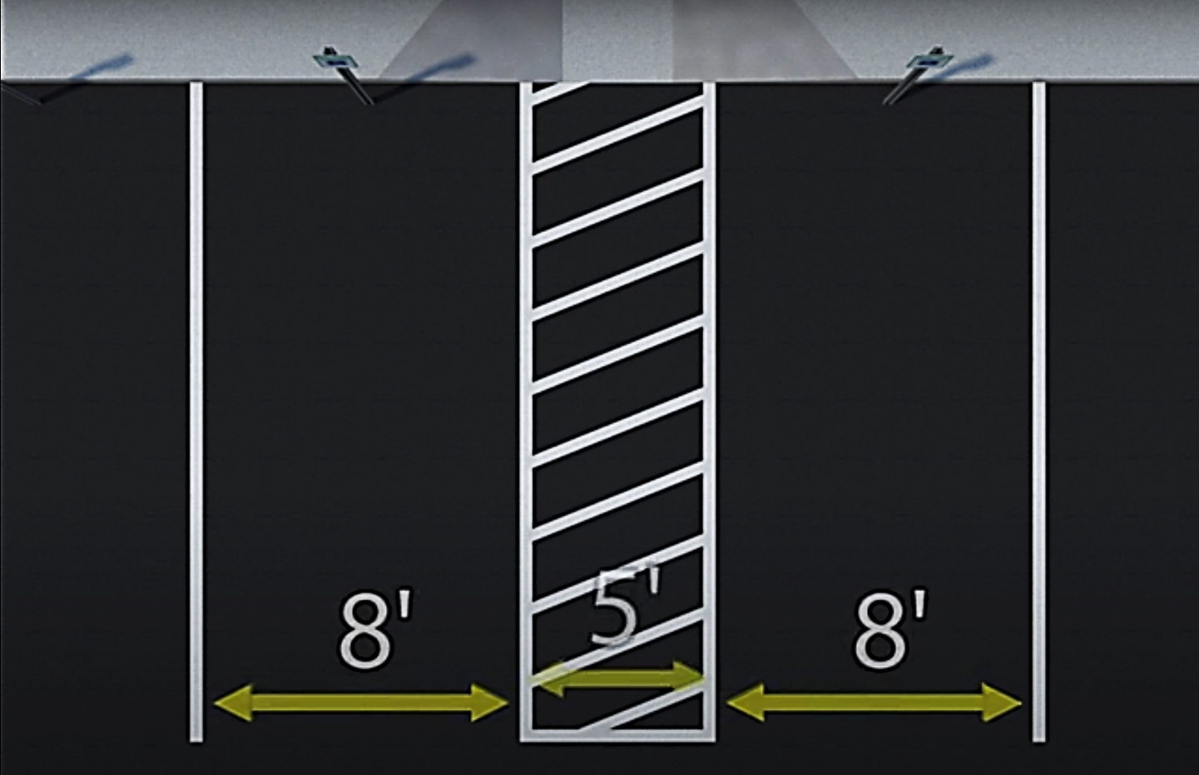
Parking Requirements – Design I
Car Parking Spaces
8’ wide minimum
5’ wide access aisle

Slide 15
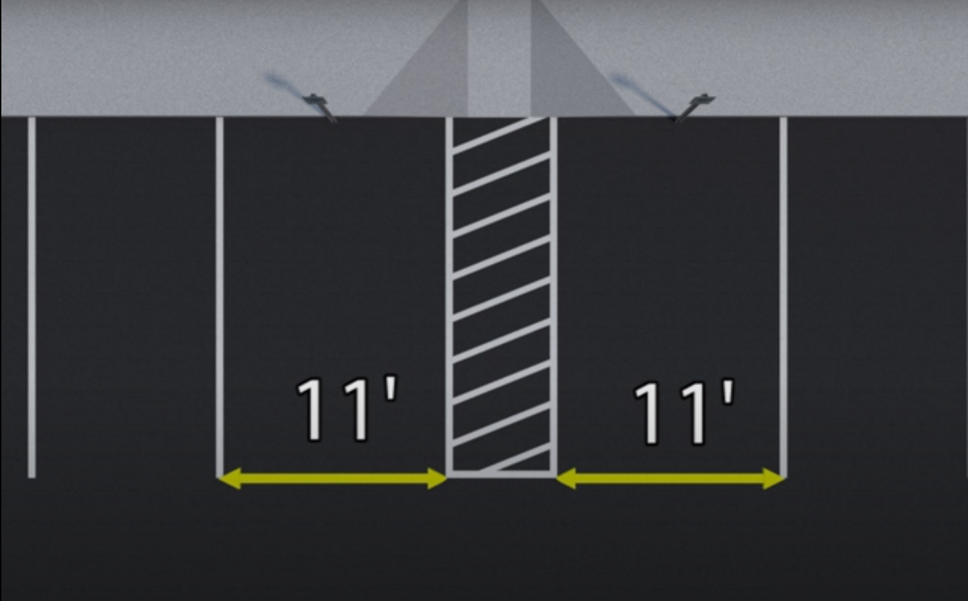
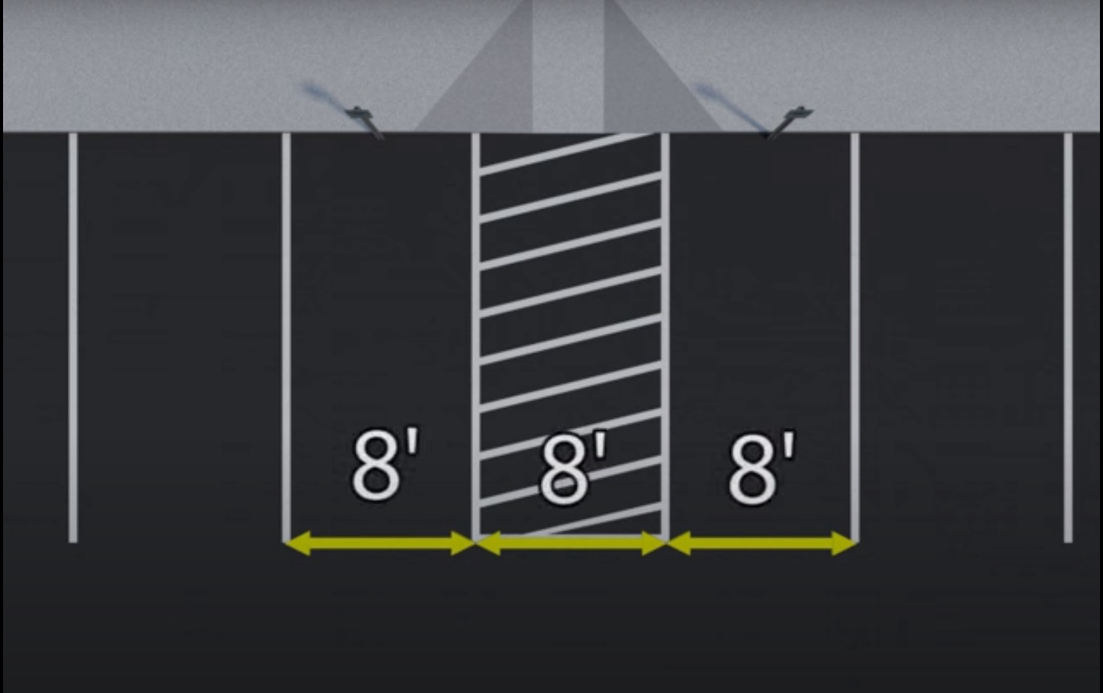
Parking Requirements – Design II
Van Parking Spaces
11’ wide minimum
5’ wide access aisle, OR
8’ wide minimum
8’ wide access aisle
Parking spaces for vans and access aisles and vehicular routes serving them shall provide a vertical clearance of 98 inches minimum.

Slide 16
Parking Requirements – Design III
Access Aisle
Must adjoin an accessible route.
Two parking spaces are permitted to share an access aisle.
Must extend the full length of the parking space.
Must be marked to discourage parking in them.
Must not overlap the vehicular way.
Van access aisles be on either side of the parking space, except with angled spaces.

Slide 17
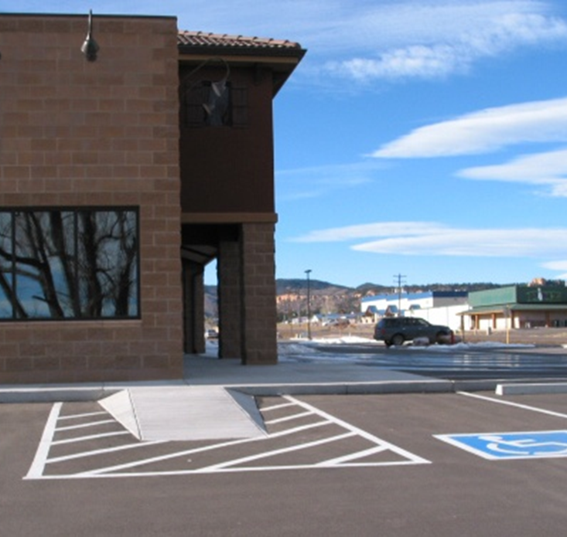
Parking Requirements – Design IV
Parking space and access aisle surfaces must be stable, firm, and slip resistant.
Access aisles must be at the same level as parking spaces they serve.
Changes in level greater than 1:48 are not permitted.
Built-up curb ramps cannot protrude into access aisles.

Slide 18
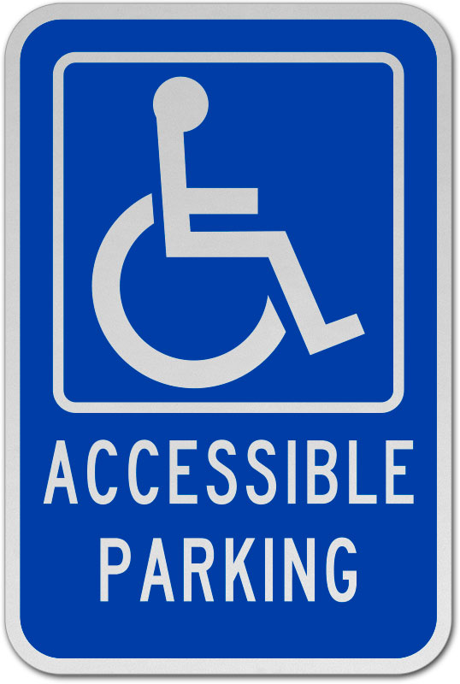
Parking Requirements – Design V
Parking spaces must be identified with the International Symbol of Accessibility.
Signs identifying van parking spaces shall contain the designation "van accessible.“
Signs shall be 5 feet minimum above the finish floor or ground surface measured to the bottom of the sign.
Signs can be installed on posts, suspended from ceilings, or fixed to walls.

Slide 19
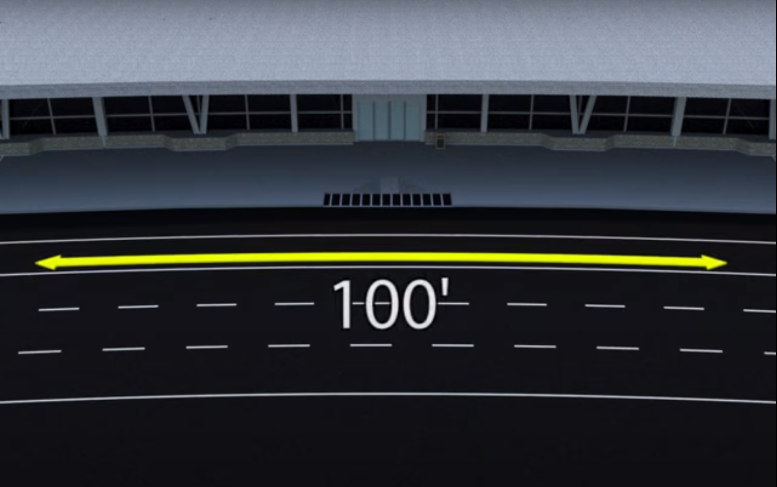
Passenger Loading Requirements – Scoping I
Where provided, at least one accessible passenger loading zone must be provided in every continuous 100 linear feet of loading zone space, or fraction thereof.

Slide 20
Passenger Loading Requirements – Scoping II
Medical Care and Long-Term Care Facilities. At least one accessible passenger loading zone shall be provided at an accessible entrance to licensed medical care and licensed long-term care facilities where the period of stay exceeds twenty-four hours.
Valet Parking. Parking facilities that provide valet parking services shall provide at least one accessible passenger loading zone.
Mechanical Access Parking Garages. Mechanical access parking garages shall provide at least one accessible passenger loading zone at vehicle drop-off and vehicle pick-up areas.

Slide 21
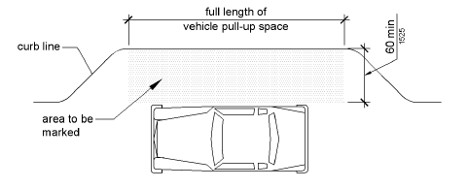
Passenger Loading Requirements – Design I
Vehicle Pull-Up Space. Passenger loading zones shall provide a vehicular pull-up space 8 feet wide minimum and 20 feet long minimum.

Slide 22
Passenger Loading Requirements – Design II
Access Aisle. Passenger loading zones shall provide access aisles adjacent to the vehicle pull-up space.
Access aisles shall adjoin an accessible route and shall not overlap the vehicular way.
Access aisles serving vehicle pull-up spaces shall be at least 5 feet wide.
Access aisles shall extend the full length of the vehicle pull-up spaces they serve.
Access aisles shall be marked to discourage parking in them.

Slide 23
Passenger Loading Requirements – Design III
Vehicle pull-up spaces and access aisles serving them must be stable, firm, and slip resistant.
Access aisles must be at the same level as the vehicle pull-up space they serve.
Changes in level greater than 1:48 are not permitted.
Vehicle pull-up spaces, access aisles, and vehicular routes must have a vertical clearance of at least 114 inches.

Slide 24
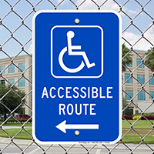
Accessible Routes - Scoping
Accessible Routes permit people with mobility disabilities to travel between site arrival points to accessible entrances.
At least one accessible route shall be provided within the site from accessible parking spaces and accessible passenger loading zones; public streets and sidewalks; and public transportation stops to the accessible building or facility entrance they serve.

Slide 25
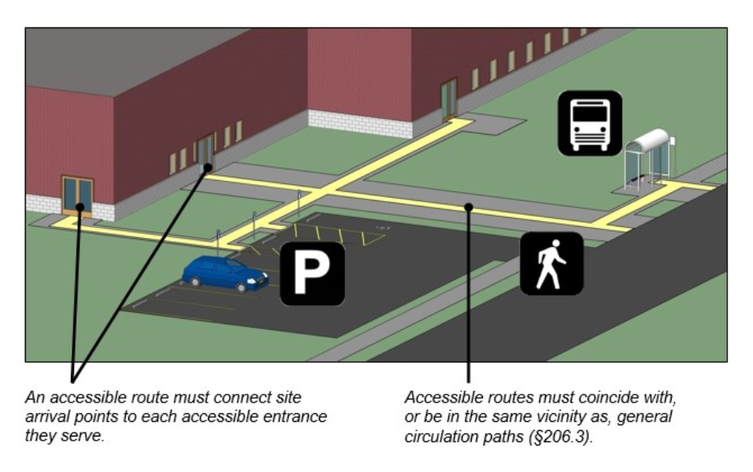
Accessible Routes - Location
The accessible route must be in the same area as the general circulation path.

Slide 26
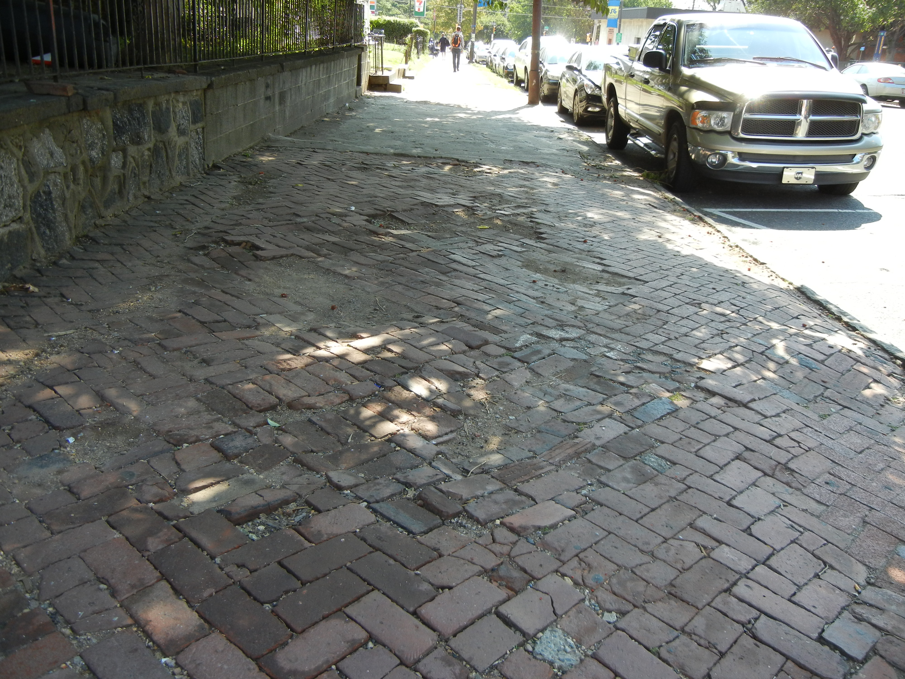
Accessible Routes – Design I
Accessible route floor or ground surfaces must be firm, stable and slip resistant.

Slide 27
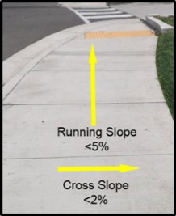
Accessible Routes – Design II
Walking surfaces should have a 5% maximum running slope
Ramps should have a 5-8.3% maximum running slope
Cross slopes should never exceed 2%.

Slide 28
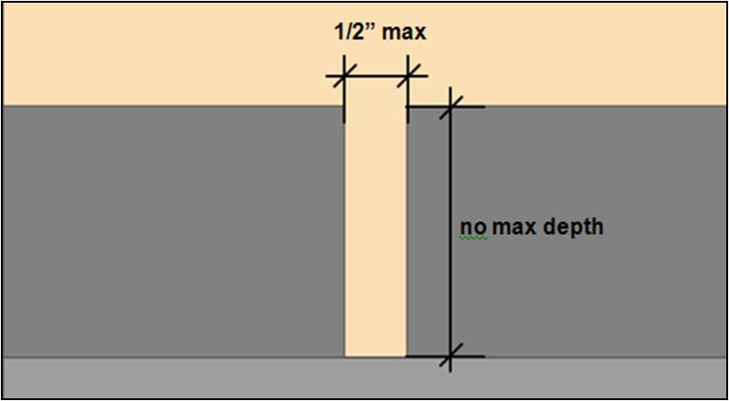
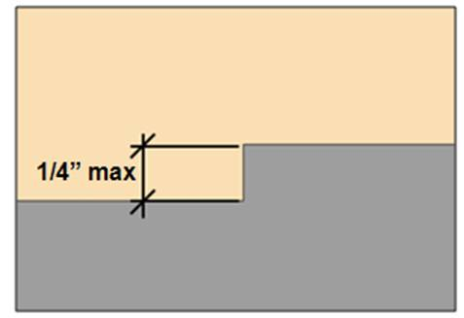
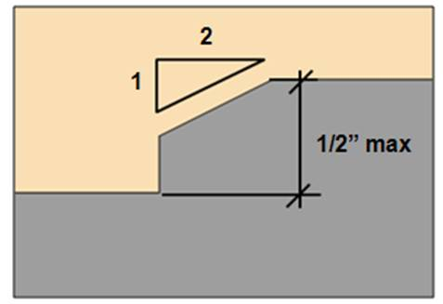
Accessible Routes – Design III
Walking surfaces should be free from gaps greater than ½ inch
Vertical changes in level cannot be greater than ¼ inch.
Vertical changes in level up to ½ inch should be beveled at 1:2.

Slide 29
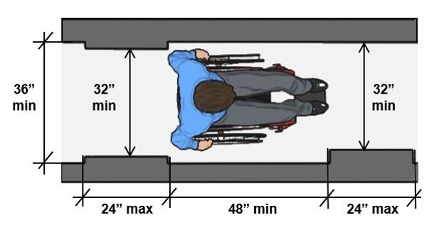
Accessible Routes – Design IV
Pathways should be 36 inches wide except at doors and for short distances, when it can be narrower (32 inches).

Slide 30
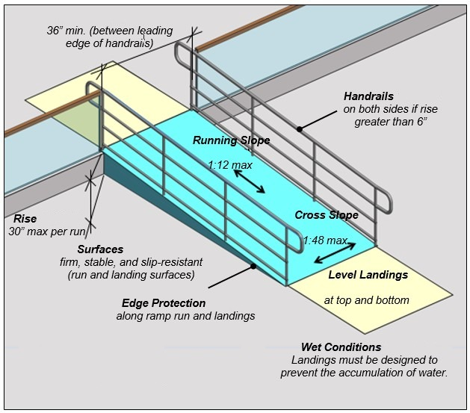
Accessible Routes – Design V
Ramps which rise more than 6 inches will need to have both handrails and edge protection.
Ramps must also have level landings at the top and bottom of each segment and where the ramp changes direction.

Slide 31
Accessible Entrances - Scoping
Part of the accessible route
Ensure people with disabilities have an accessible way in
At least 60% of all public entrances must be accessible.
If direct access to a facility entrance is from a parking structure, each direct access entrance must be accessible.
If direct access to a facility entrance is from a pedestrian tunnel or elevated walkway, at least one direct entrance to the facility must be accessible.

Slide 32
Accessible Entrances – Design I
Revolving doors, revolving gates, and turnstiles not allowed.
At least one side of double doors must be accessible.
Door openings must have a clear width of at least 32 inches.
No protrusions below 34 inches from ground. Protrusions between 34-80 inches above the ground are limited to 4 inches.
Thresholds at doorways can be no more than ½ inch high. Floor or ground surface requirements apply.

Slide 33
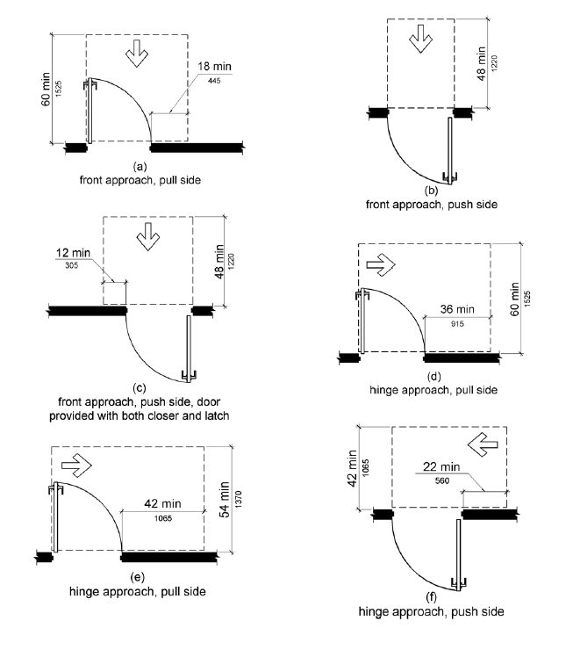
Accessible Entrances – Design II
Maneuvering clearances are required and vary.

Slide 34
Accessible Entrances – Design III
Operable parts of doors must not require tight grasping, pinching or twisting of the wrist.
Operable parts of doors must be 34-45 inches above the ground.
Doors must close at a speed of no less than 5 seconds.

Slide 35
Drive-Thru Medical Testing Sites
Allow for intermittent medical services
May be in a parking lot of hospital, retail store or fairground
Typically consist of pop-up tents and traffic cones
Useful in viral outbreaks to help minimize exposure to others
Operations must comply with the Americans with Disabilities Act

Slide 36
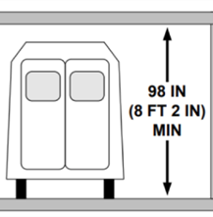
Wheelchair Access at Drive-Thru Testing Sites I
Minimum clearance for wheelchair-accessible vans is 8 feet, 2 inches high

Slide 37
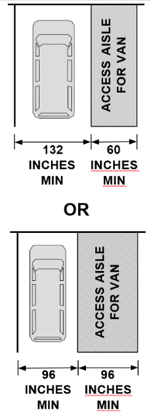
Wheelchair Access at Drive-Thru Testing Sites II
Wheelchair users need access aisle alongside vehicle if exiting the vehicle is required

Slide 38
Walk-Up Services at Drive-Thru Sites
Walk-up services may be needed for those unable to arrive by vehicle
Ensure accessible route connecting all elements of testing
Check-in
Testing area
Paperwork/instruction area
Check-out

Slide 39
Accessible Routes
Interior accessible routes must comply with the following:
Clear width of 36 inches
Passing space of 60 inches every 200 feet
No change in level of more than ¼ inch, or ½ inch if beveled
Running (forward) slope no greater than 5 percent (1:20)
Cross slope (side-to-side) no greater than 2 percent (1:48)
Firm, stable & slip resistant
Notes:
To ensure equitable access to care, health care providers must take appropriate steps to ensure that their facilities and offices meet the architectural accessibility requirements of the ADA. Moreover, they must provide effective communication that patients require. For example, patients who are deaf may require a Sign Language interpreter (ASL). Or an individual who has a vision disability may require materials in alternative formats.
Accessible medical equipment such as height-adjustable examination tables ensure that individuals with mobility disabilities can get on the table and be examined. This gives an equal opportunity to receive health care services.
The ADA also requires reasonable modifications in policies, practices, and procedures when necessary to afford goods and services to a person with a disability. For example, reasonable modifications may include modifying the level of language used for some people with cognitive, learning or other intellectual disabilities or modifying standard exam time.
If the health care provider can demonstrate that modifying the policy or practice would fundamentally alter the nature of the goods and services provided, then there is no requirement for the modification.
For more information about the ADA, see the US Department of Justice website at: http://www.ada.gov/

Slide 40
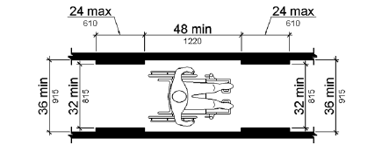
Walking Surfaces in Accessible Routes
The clear width may be reduced to 32” minimum for a length of 24” maximum, provided that reduced width segments are separated by segments that are 48” long minimum and 36” wide minimum

Slide 41
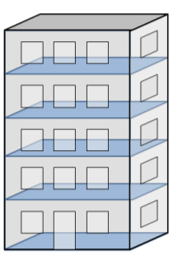
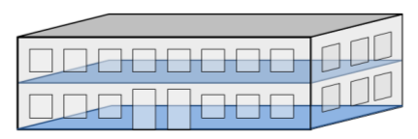
Accessible Route Multi-Story Exception
Accessible route between floors
(“elevator exemption”)
Private sector facilities only that are:
Less than 3 stories (above or below grade)
OR less than 3,000 square feet per story

Slide 42
Elevator Exemption
Exemption not allowed for:
Shopping centers/ malls with 5 or more sales or retail establishments
Professional offices of health care providers
Terminal, depots, or stations used for public transportation
Government facilities where
2 stories only AND
where 1 story has no public space AND
maximum occupancy of 5

Slide 43
Employee Work Areas & Exempt Areas
Mechanical spaces are generally exempt from accessibility requirements
Employee work areas must comply with
Accessible route requirements
Egress (exiting) requirements
Visible alarms (when audible alarms exist)
Employee work areas need not comply with accessible route requirements if they are <1,000 square feet
Notes:
To ensure equitable access to care, health care providers must take appropriate steps to ensure that their facilities and offices meet the architectural accessibility requirements of the ADA. Moreover, they must provide effective communication that patients require. For example, patients who are deaf may require a Sign Language interpreter (ASL). Or an individual who has a vision disability may require materials in alternative formats.
Accessible medical equipment such as height-adjustable examination tables ensure that individuals with mobility disabilities can get on the table and be examined. This gives an equal opportunity to receive health care services.
The ADA also requires reasonable modifications in policies, practices, and procedures when necessary to afford goods and services to a person with a disability. For example, reasonable modifications may include modifying the level of language used for some people with cognitive, learning or other intellectual disabilities or modifying standard exam time.
If the health care provider can demonstrate that modifying the policy or practice would fundamentally alter the nature of the goods and services provided, then there is no requirement for the modification.
For more information about the ADA, see the US Department of Justice website at: http://www.ada.gov/

Slide 44
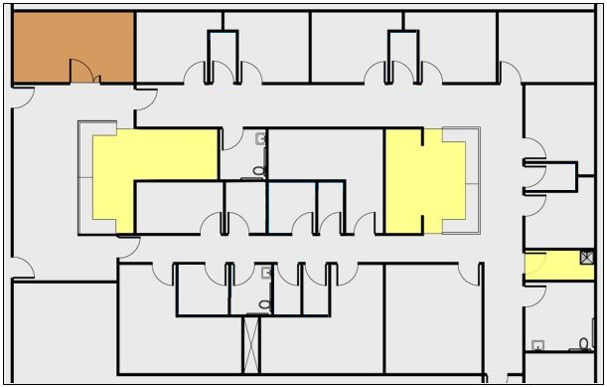
Example: Medical Care Suite
Employee Work Areas & Exempt Spaces
Mechanical (exempt)
Employee Only Work Areas
Reception/ Files
Nurses’ Station
Janitor’s Closet

Slide 45
Doors
Doors must have:
32 inches clear width
36 inch clear width if > 24 inches deep
No projections into clear width below
34 inches
Lever handle hardware placed between 34 & 48 inches
Door closers cannot project more than
4 inches if they are below 80 inches
Notes:
To ensure equitable access to care, health care providers must take appropriate steps to ensure that their facilities and offices meet the architectural accessibility requirements of the ADA. Moreover, they must provide effective communication that patients require. For example, patients who are deaf may require a Sign Language interpreter (ASL). Or an individual who has a vision disability may require materials in alternative formats.
Accessible medical equipment such as height-adjustable examination tables ensure that individuals with mobility disabilities can get on the table and be examined. This gives an equal opportunity to receive health care services.
The ADA also requires reasonable modifications in policies, practices, and procedures when necessary to afford goods and services to a person with a disability. For example, reasonable modifications may include modifying the level of language used for some people with cognitive, learning or other intellectual disabilities or modifying standard exam time.
If the health care provider can demonstrate that modifying the policy or practice would fundamentally alter the nature of the goods and services provided, then there is no requirement for the modification.
For more information about the ADA, see the US Department of Justice website at: http://www.ada.gov/

Slide 46
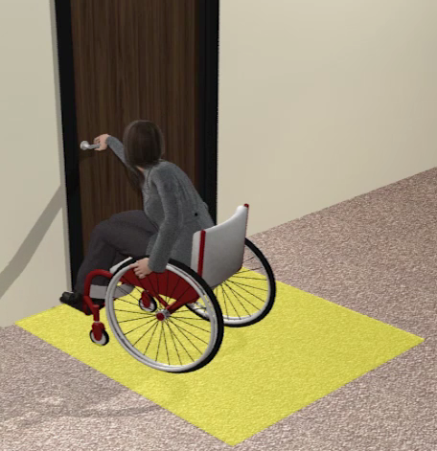
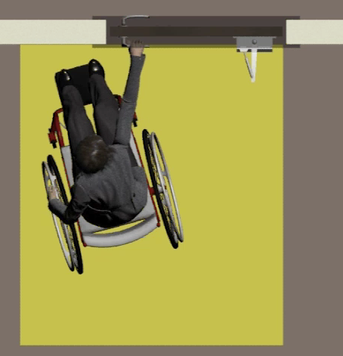
Maneuvering Clearances
Minimum space for positioning/ maneuvering at doors

Slide 47
Maneuvering Clearances - Overlap
Required at each accessible door based on approach & swing
Door maneuvering clearances can overlap

Slide 48
Maneuvering Clearances - Offset
Maneuvering clearance measured from the wall - Cannot be offset more than 8” from the face of the door.

Slide 49
Maneuvering Clearances – Recessed Door
Recess: 8” max. Recess: greater than 8”

Slide 50
Maneuvering Clearances at Doors/Gates Table
Type of Use |  | Minimum Maneuvering Clearance
Approach Direction | Door or Gate Side | Perpendicular to Doorway | Parallel to Doorway (beyond latch side unless noted)
From front | Pull | 60 inches (1524 mm) | 18 inches (455 mm)
From front | Push | 48 inches (1219 mm) | 0 inches (0 mm)¹
From hinge side | Pull | 60 inches (1525 mm) | 36 inches (915 mm)
From hinge side | Pull | 54 inches (1370 mm) | 42 inches (1065 mm)
From hinge side | Push | 42 inches (1065 mm)² | 22 inches (560 mm)³
From latch side | Pull | 48 inches (1220 mm) ⁴ | 24 inches (610 mm)
From latch side | Push | 42 inches (1065 mm)⁴ | 24 inches (610 mm)
1. Add 12 inches (305 mm) if closer and latch are provided.
2. Add 6 inches (150 mm) if closer and latch are provided.
3. Beyond hinge side.
4. Add 6 inches (150 mm) if closer is provided.

Slide 51
Clustered Areas
Accessible dressing rooms & toilet rooms can be grouped or “clustered” if:
5 percent of each type of dressing room, or at least 1, comply with accessibility requirements in ADA 803
50 percent of the clustered toilet rooms, at least 1, comply with the accessibility requirements for toilet rooms in ADA 603
The rooms are in the same general area
They serve the same group of people (i.e., the public vs employees)
Notes:
To ensure equitable access to care, health care providers must take appropriate steps to ensure that their facilities and offices meet the architectural accessibility requirements of the ADA. Moreover, they must provide effective communication that patients require. For example, patients who are deaf may require a Sign Language interpreter (ASL). Or an individual who has a vision disability may require materials in alternative formats.
Accessible medical equipment such as height-adjustable examination tables ensure that individuals with mobility disabilities can get on the table and be examined. This gives an equal opportunity to receive health care services.
The ADA also requires reasonable modifications in policies, practices, and procedures when necessary to afford goods and services to a person with a disability. For example, reasonable modifications may include modifying the level of language used for some people with cognitive, learning or other intellectual disabilities or modifying standard exam time.
If the health care provider can demonstrate that modifying the policy or practice would fundamentally alter the nature of the goods and services provided, then there is no requirement for the modification.
For more information about the ADA, see the US Department of Justice website at: http://www.ada.gov/

Slide 52
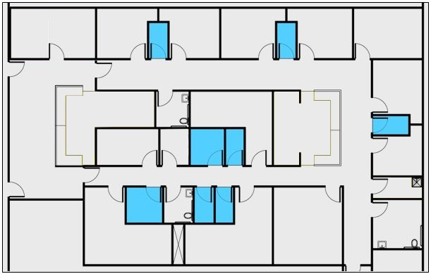
Example: Medical Care Suite
Public & Common Use Areas: Full Access
Dressing Rooms: access to at least 5% of each type
Exams Rooms & Doctors’ Offices: 100% scoping (public access)
Waiting Room
Break Room
Toilet rooms – access to all
(50%: clustered single user of same type)

Slide 53
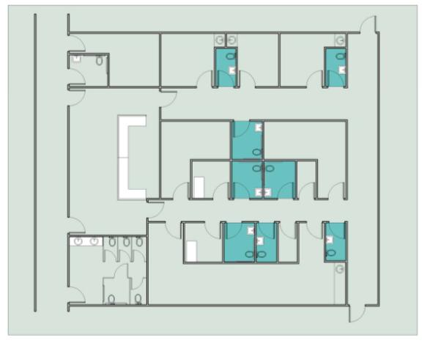
Clustered Toilet Rooms
Access to at least 50% of single user toilet rooms clustered at 1 location & serving same users

Slide 54
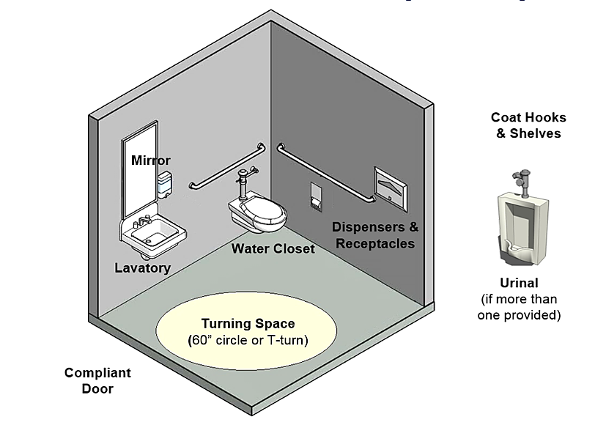
Toilet Rooms (§603)

Slide 55
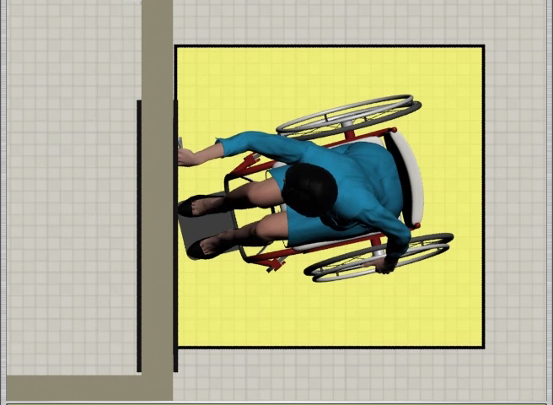
Toilet Rooms – Exterior Door Maneuvering Clearance

Slide 56
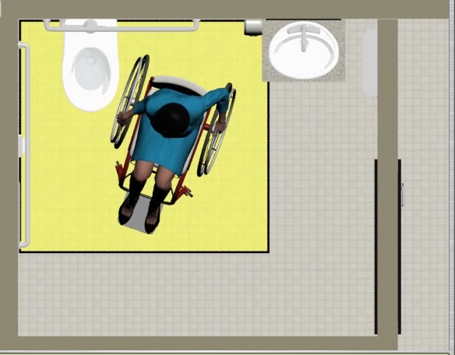
Toilet Rooms - Clear Floor Space at Toilet for Approach & Transfer

Slide 57
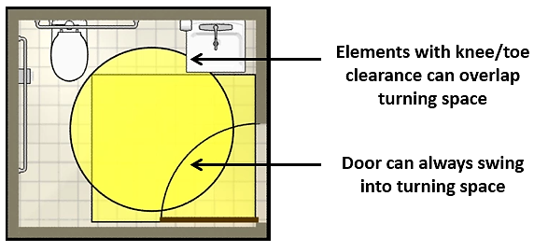
Toilet Rooms – Turning Space
60” diameter circle or “T” shaped space

Slide 58
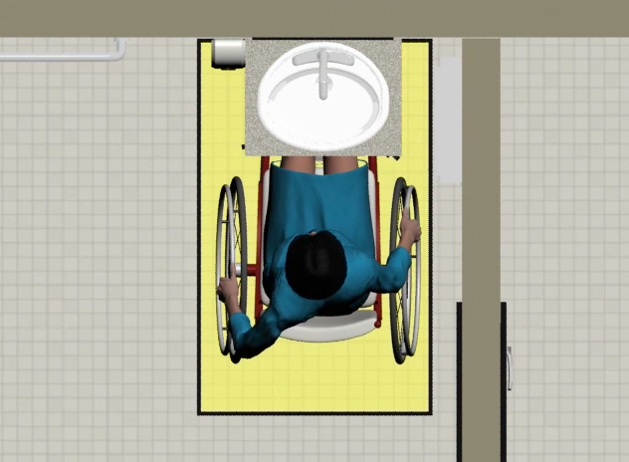
Toilet Rooms - Clear Floor Space at Fixtures & Elements

Slide 59
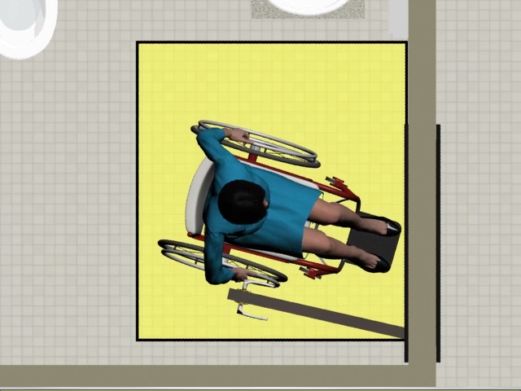
Toilet Rooms - Interior Door Maneuvering Clearance

Slide 60
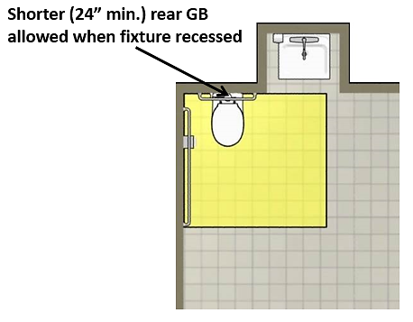
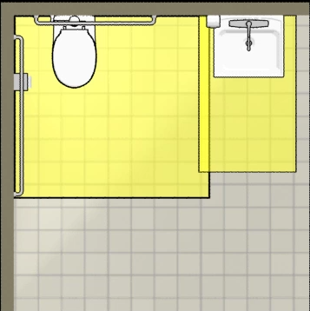
Toilet Rooms – No Overlap of Lavatory & Toilet Clearances

Slide 61
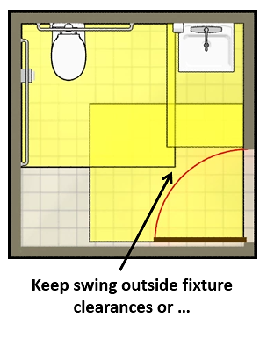
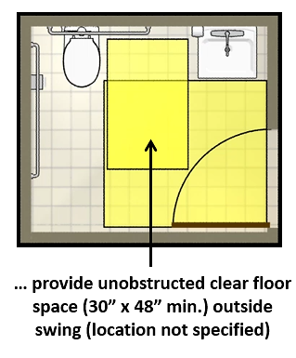
Toilet Rooms – Interior Door Maneuvering Clearance

Slide 62
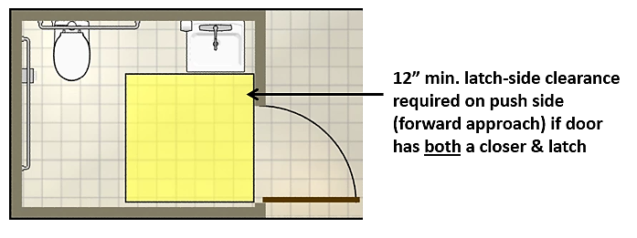
Toilet Rooms – Out-swinging Doors
Out-swinging doors allow smaller room size (require less interior maneuvering clearance)

Slide 63
Accessible Check-In Areas
The check-in counter in a medical office or hospital must meet the following:
A portion of the counter surface 36 inches long minimum and 36 inches high maximum above the finish floor must be provided.
A clear floor or ground space complying with ADA 305 must be positioned for a parallel approach adjacent to the 36 inch minimum length of counter; or
must be positioned for a forward approach to the counter (with knee & toe clearance)

Slide 64
Accessible Examination Rooms
Accessible examination rooms must have:
an accessible route to and through the room;
an entry door with adequate clear width, maneuvering clearance, and accessible hardware;
appropriate models and placement of accessible examination equipment; and
adequate clear floor space inside the room for side transfers and use of lift equipment

Slide 65
Medical Diagnostic Equipment (MDE) Standards
Issued by the U.S. Access Board, the MDE Standards:
are found in the Rehabilitation Act section 510
provide technical criteria
are voluntary unless adopted by an enforcing authority (e.g., DOJ under the ADA, HHS under the Rehabilitation Act)
can be used by FDA to verify labelling claims

Slide 66
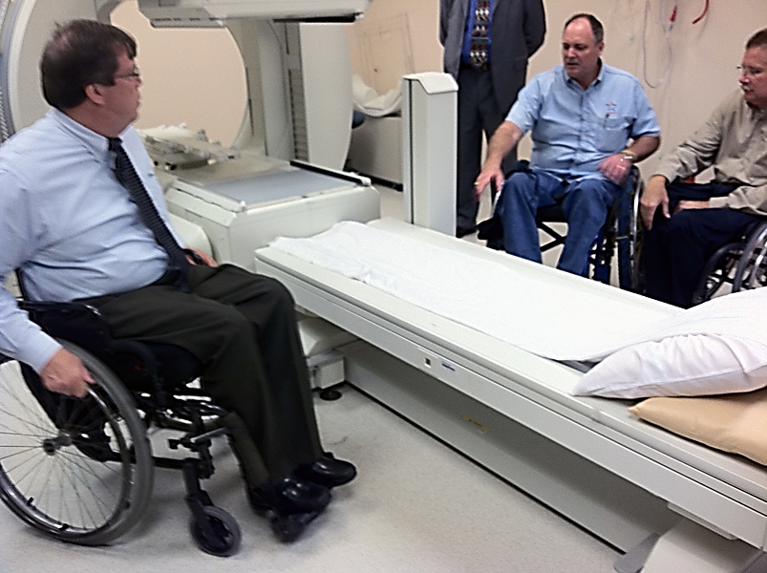
Equipment Covered
examination tables
examination chairs (including those used for dental or optical exams)
weight scales
x-ray machines
mammography equipment
other MDE

Slide 67
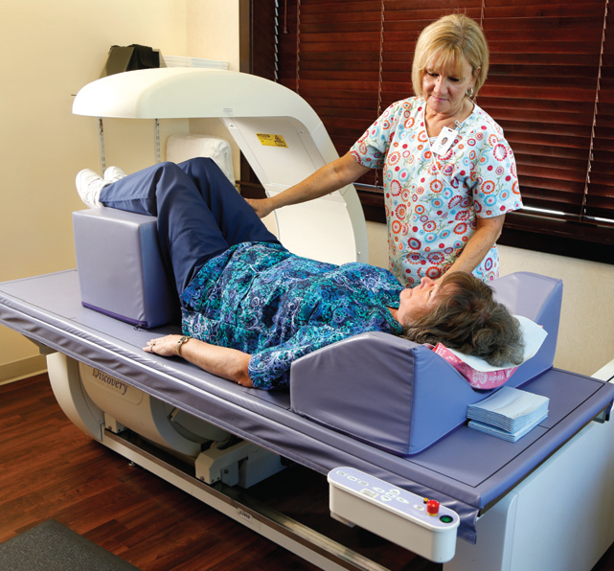
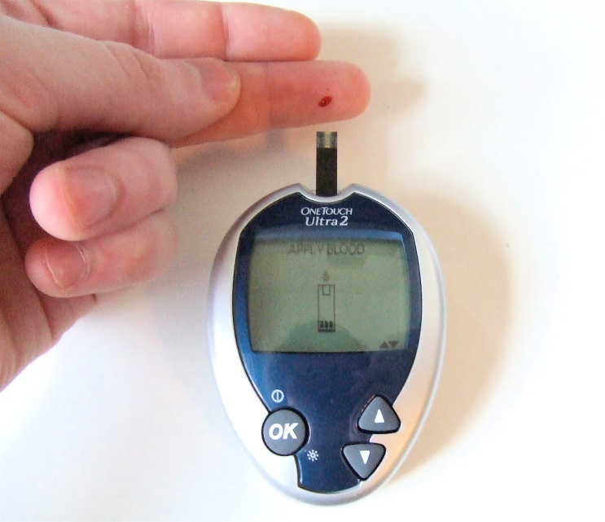
Equipment Not Covered
Standards do not apply to personal devices or positioning aids

Slide 68
MDE Technical Requirements
Apply based on patient position for use:
Supine, Prone, or Side Lying (M301)
Seated (M302)
In Wheelchair (M303)
Standing (M304)
Also address: supports (M305), communication (M306) & operable Parts (M307)

Slide 69
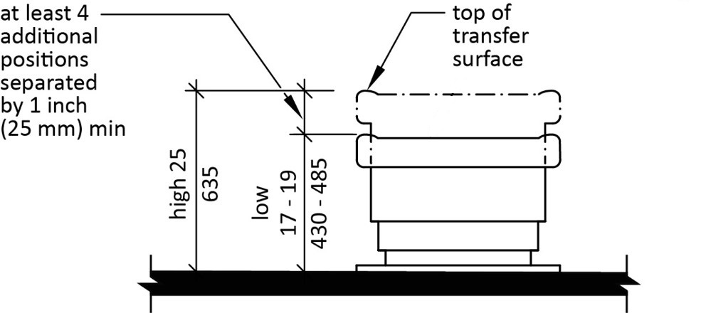
Supine, Prone or Side-Lying MDE Transfer Surface
Adjustable Heights
Low: 17 – 19”
High: 25”
Additional Heights: at least 4 between low and high separated by at least 1”

Slide 70
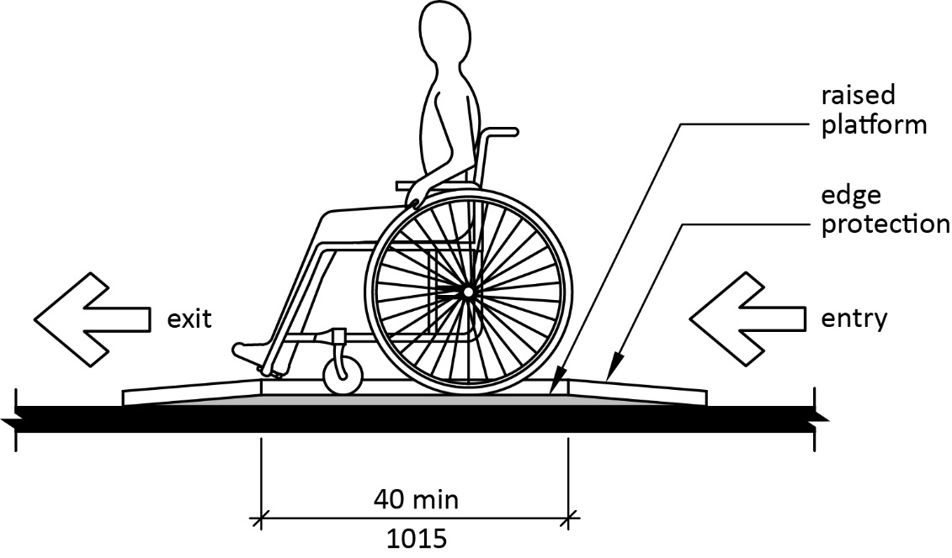
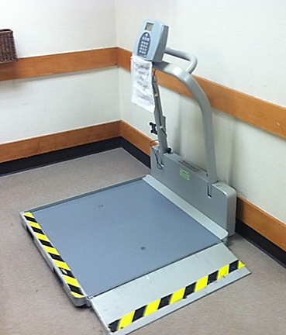
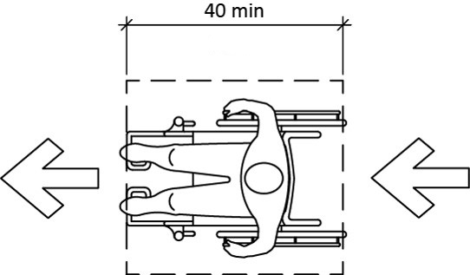
Seated in a Wheelchair Pass Through Entry/ Exit MDE

Slide 71
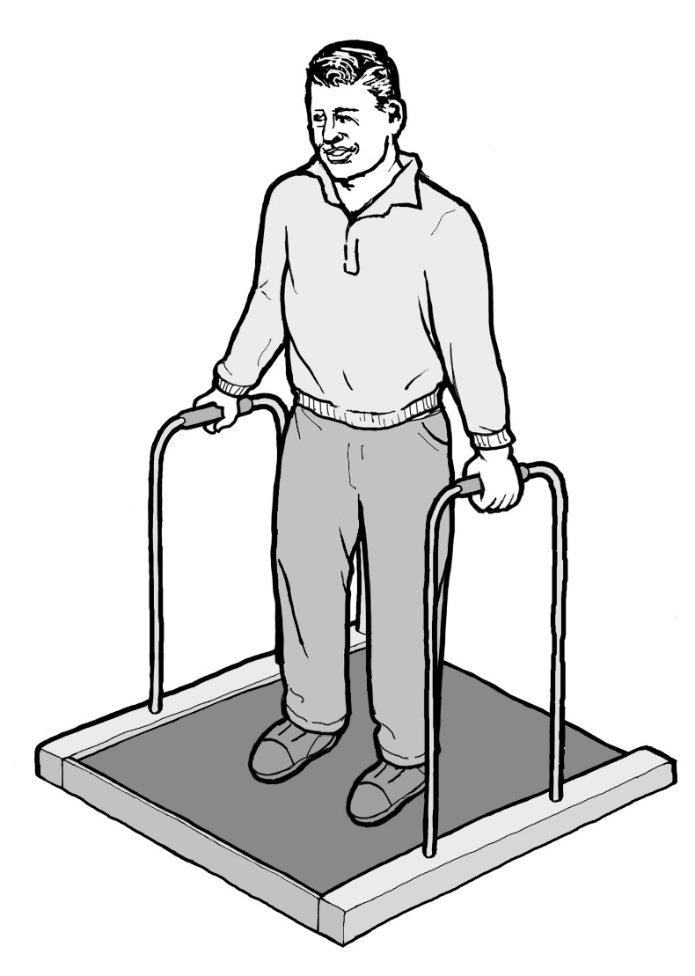
Standing MDE Requirements
Slip-resistant surface
Vertical support gripping surface:
18” long min
34” - 37” height (lower end of gripping surface)
Horizontal support gripping surface:
4” long min
34” - 38” height (top of gripping surface)

Slide 72
Tax Incentives
Health care providers can receive tax incentives for physical accessibility changes, transportation accessibility modifications, and communication accessibility expenses
View the ADA National Network Quick Tips - https://adata.org/factsheet/quicktips-tax
Consult your tax professional

Slide 73
Resources
2010 ADA Standards - https://www.ada.gov/regs2010/2010ADAStandards/2010ADAstandards.htm
Medical Diagnostic Equipment - https://www.access-board.gov/guidelines-and-standards/health-care/about-this-rulemaking
ADA National Network – www.adata.org
Rocky Mountain ADA Center – https://www.rockymountainada.org
Pacific ADA Center - https://www.adapacific.org

